Slide 1

TOPIC: WEB APPLICATION FOR DETECTION OF ROUTES BETWEEN TWO STATIONS WITH NO DIRECT TRAIN CONNECTIVITY
Under the Guidance of:
Dr. Risha Mal
Name | Scholar Id
Vivek Kumar | 1813030
Sushant Kumar | 1813063

Slide 2
CONTENTS
Introduction
Motivation
The Dire Need
The Rescue
Brute Force Approach
The Challenges
Fixing The Issue With Case
Suggesting A Name
Complexity Analysis
Time Complexity
Space Complexity
Optimizing The Time Complexity
The Prototype
References

Slide 3
INTRODUCTION
In this Project we are trying to implement an idea which will deduce route when there is no direct train found between source and destination. IRCTC database contains a large number records of Train schedule with there arrival and departure time from every station with every possible details. This data has to be conﬁgured to produce the shortest and multiple alternate path through a given set of operations.
From the given data base, where every particular trains has a several stoppage at several stations, our task is to find the any simple path from a given source station to a given destination station. Simple Path is the path from one station to another such that no station is visited more than once. If there is no simple path possible then just return “Not possible” otherwise it will show every possible ways to reach the destination.

Slide 4
MOTIVATION
Railways are the most opted form of transport now a days. If we look over the data ,on an average the railway network transported over 22 million passengers every day.
Many Small villages or towns which contains a local Railways station but if they have to went to any farther location first of all they have to reach to a Station which have higher connectivity.
Above Problem is solved by traversing through all simple paths connecting between initial station to final station using a modified version of Search and find the minimum cost and time taking path amongst them. A simple solution is to start from source, go to all adjacent vertices, and in recursive manner for further adjacent stations until we reach the destination.

Slide 5
THE DIRE NEED
There are 22 millions people boarding and arriving at almost 7,325 stations across all over india. Out of these 7,325 stations , not every stations are well connected. So, we can’t ignore the fact that many people has to use some connecting trains between two stations.
For an instance let us take an example of a person who wants to go from Patna(capital of Bihar) to Silchar. If we try to search any train on any day except on Friday, it shows no direct train available. The problem is that if the person has never travelled in this route, he will have to search for every stations between Patna and Silchar.
Even if we consider 1% of people travelling has to face this problem than almost 2.2 millions people face this problem everyday.
So, considering above facts there is a dire need to solve this problem.

Slide 6
THE RESCUE
Here comes the rescue, Train Trip, as we call it, gives the possible route for any two given stations even if there is no direct train between given source and destinations.
If there are multiple possibilities between source and destinations, then it gives the list arranged in the form of laps.
Also, there will be a section named waiting time which will give how much time a person must wait before he or she can board to next train.

Slide 7
Implemented APPROACH
In this approach, we have changed the way in which data (database of trains) has been stored. In the above two cases, we have suggested GRAPH in which all the details of train is stored. Just like a web. But here due to several limitations, we are taking vector of vectors. In place of vector of vectors we can also take 2-D matrix. But to optimise space we have taken vector of vectors.[3]
If we have ‘n’ number of trains, then we are forming ‘n’ numbers of vectors. These each vectors representing a particular train. Further these ‘n’ each and every vectors contain another vector, which store all details about the stoppage of that particular train from which that vector belongs. Lets consider 1st train has ‘m’ stoppage, then 1st vector contains vector of m size, storing details of every ‘m’ stoppage junction.

Slide 8
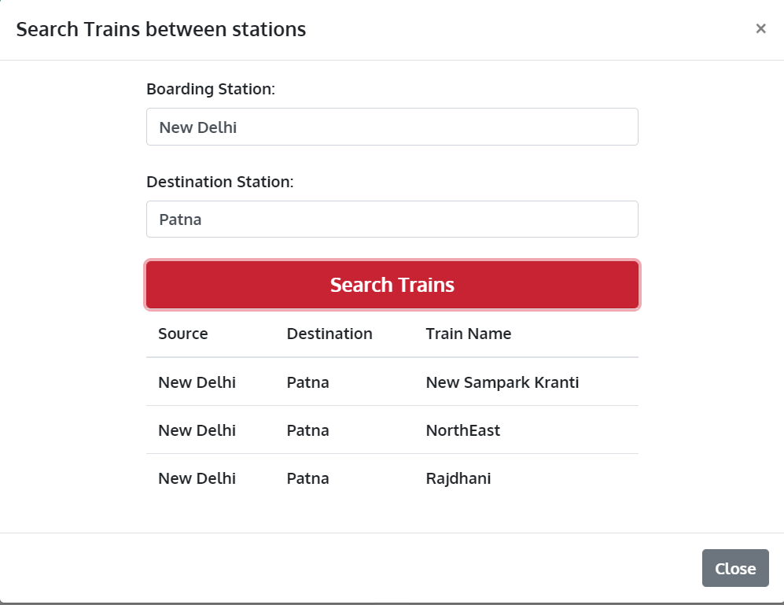
For Direct Trains:
Lets say X = Source,
Y = Destination.
Finding direct trains is an easy task. What we will do is that we first try to traverse the whole trains and find if the source is present or not. If the source is present then we start searching just after that. If we find the destination too then there is direct train between given stations. So, we display the required trains.
Fig: 1: For Direct Trains

Slide 9
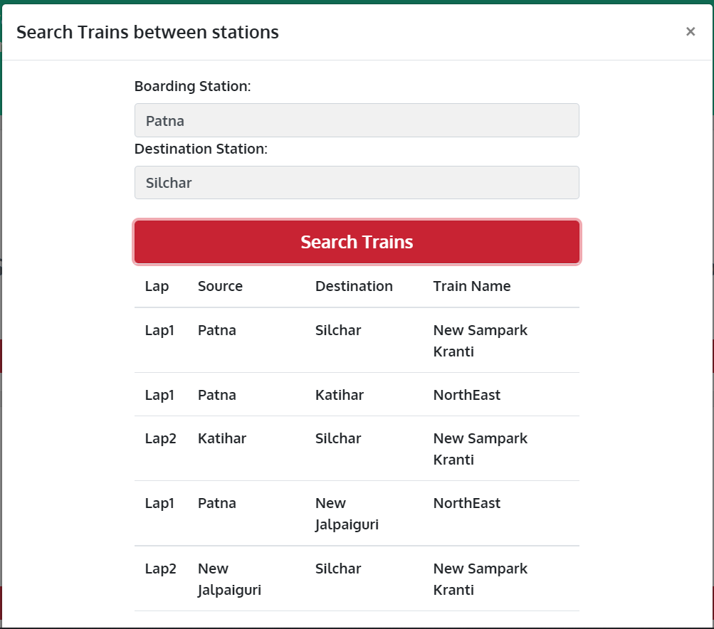
For Indirect Trains:
Finding indirect train is not that much easy. We have considered brute force solution to achieve this. We first traverse the whole array and try to find the source in the array. If we are able to find the source in the array then we just call on function which gives the direct train between two stations. We do this for every stations which is present later in the array. So, in this way we can find the indirect trains for any two source and destination.
Fig: 2: For Indirect Trains

Slide 10
THE CHALLENGES
Although project till now was great and it served its purpose but there were some glitches associated with it.
Some necessary features like suggesting a name when someone types any letter were missing.
Some other improvements like optimizing the code ,scaling the databases have also been tried.
Issues related with upper case and lower case have also been fixed as discussed in later slides.
The duration of each journey should also be shown.
The waiting time should also be shown.

Slide 11
FIXING ISSUE WITH UPPER CASE AND LOWER CASE
In previous code, if we try to search any station in all capital letters or all small letters or mixed capital and small letters then it will not show any result.
So to solve this problem we have first converted all the letters of source and destination to lower case using the JavaScript function to Lowercase() and then we have used this source and destination to compute all our results.[1]
We could have used some other utilities like lodash to solve this issue
While showing the results we again converted back to standard format i.e., first letter capital and rest small.

Slide 12
SUGGESTING A NAME
To make web application more user friendly we have added this feature. Whenever someone starts typing any name JavaScript running in the background will search for the possible names and will suggest it to the user.
For example if someone has to write Silchar then just after typing S in the search bar, all the names starting with S will be shown below. Again when the user types I i.e., Si then all the names starting with si will be shown in the space.
This feature will make user easy to type anything. Moreover it will also reduce typing errors.
Although it was a bulky code so it was impossible to show code here that is why a glimpse of its code and its working has been shown in the next slide.

Slide 15
Showing distances
Proceeding further with the web app, we have tried to display the distance between each stations.
For example, if we have to go from New Delhi to Silchar , and let us suppose that we take a route first from New Delhi to Kanpur then Kanpur to Silchar then in both laps distance covered will be shown.
The data has been taken from authentic irctc web page.
The distance has been stored with the help of map.

Slide 16
Showing train number and fare:-
Apart from displaying distance between two stations, we will be displaying the train number and fare for the convenience of user.
Train number has been stored with the help of vectors and variables but in case of fare, we have used maps to store it.
Although it was almost impossible for us to show the fare since there are many types of bookings. Also fare is different for different types of trains.
So, to tackle this problem only one type of booking has been considered.
We have considered the fare to be same for every train.

Slide 17
COMPLEXITY ANALYSIS
Algorithmic complexity is a measure of how long an algorithm would take to complete given an input of size n. If an algorithm has to scale, it should compute the result within a finite and practical time bound even for large values of n. For this reason, complexity is calculated asymptotically as n approaches infinity
While complexity is usually in terms of time, sometimes complexity is also analyzed in terms of space, which translates to the algorithm's memory requirements.
So generally two types of complexity are kept in mind while writing any algorithm
These two complexities are time complexity and space complexity

Slide 18
TIME COMPLEXITY
Time Complexity is the amount of time taken by an algorithm to run, as a function of the length of the input. It measures the time taken to execute each statement of the code in an algorithm.[4]
For any defined problem, there can be N number of solution. This is true in general. If I have a problem and I discuss about the problem with all of my friends, they will suggest me different solutions. And I am the one who has to decide which solution is the best based on the circumstances.[4]
Time Complexity is most commonly estimated by counting the number of elementary step performed by any algorithm to finish execution. Algorithm’s performance may vary with different types of input data, hence for an algorithm we usually use the worst-case Time complexity of an algorithm because that is the maximum time taken for any input size.[4]

Slide 19
SPACE COMPLEXITY
The space complexity of an algorithm or a computer program is the amount of memory space required to solve an instance of the computational problem as a function of characteristics of the input. It is the memory required by an algorithm until it executes completely.[3]
Space complexity is an amount of memory used by the algorithm (including the input values of the algorithm), to execute it completely and produce the result. We know that to execute an algorithm it must be loaded in the main memory. The memory can be used in different forms:
Variables (This includes the constant values and temporary values)
Program Instruction
Execution

Slide 20
OPTIMISING THE TIME COMPLEXITY
The time complexity of Previous code was not that much good. For direct trains it was N*N and for indirect trains it was N raised to power 3.
Instead of making vector of trains we will make adjacency matrix of stations.
Every train has its own adjacency matrix.
Let us suppose that there are total of 16 stations i.e., a train crosses total of 16 stations then then we will make a matrix of size 16x16.
If there is a train connects two stations let us suppose station A and station B for instance then adjacency matrix will store 1 at the index matrix[A][B].
Initially the matrix will be filled with 0 denoting that there is no train between any of two stations.

Slide 21
THE COST
For optimizing the time complexity, we had to take n adjacency matrix where n is the total number of trains.
For each train there was a matrix of size m*m where m was the total number of stations that particular train was visiting.
So, we were able to reduce the time complexity from n*n to O(1) for direct train.
For indirect train we were able to reduce time complexity from O(n*n*n) to O(n).
But we had to take adjacency matrix which cost us a total of m*n*n space where m is total number of trains and m is the total number of stations where train stops.

Slide 22
Webpage to Android App
We are also building an App which is performing the same function as the web page.
Apps are the applications that are downloaded and installed on our android devices, rather than being rendered within the browser.
Apps are much faster and tends to be more advanced n terms of features and functionality.
Average time spent on the App is estimated is very less as compared to the time spent in surfing the web pages which are performing the same task.
Now Apps are becoming a part of our daily routine and there are very few who live in an isolated world away from Android apps.
Apps has flexible interfaces and supports complex functionalities.

Slide 23
Technology Required for an App
Android Studio: It is the official integrated development environment (IDE) for Google’s Android Operating System, built on JetBrains IntelliJ IDEA software and designed specifically for Android development. Android Studio supports many programming languages like Java, C++, Kotlin etc.[5]
Java: Java is one of the powerful general-purpose programming languages. Android heavily relies on the Java programming language all the SDKs required to build for an android applications use the standard libraries of Java.[7]

Slide 24
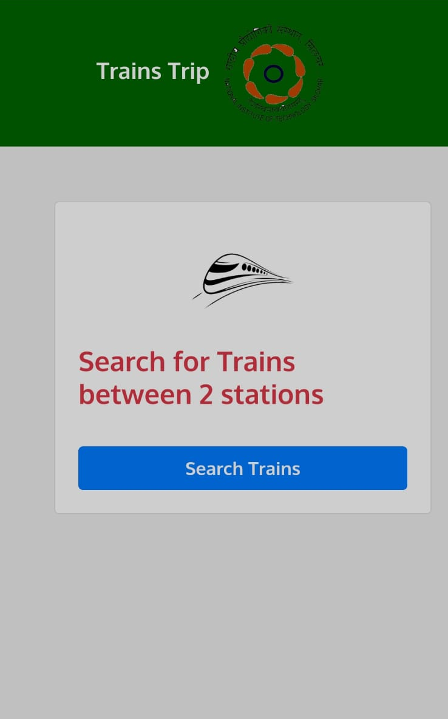
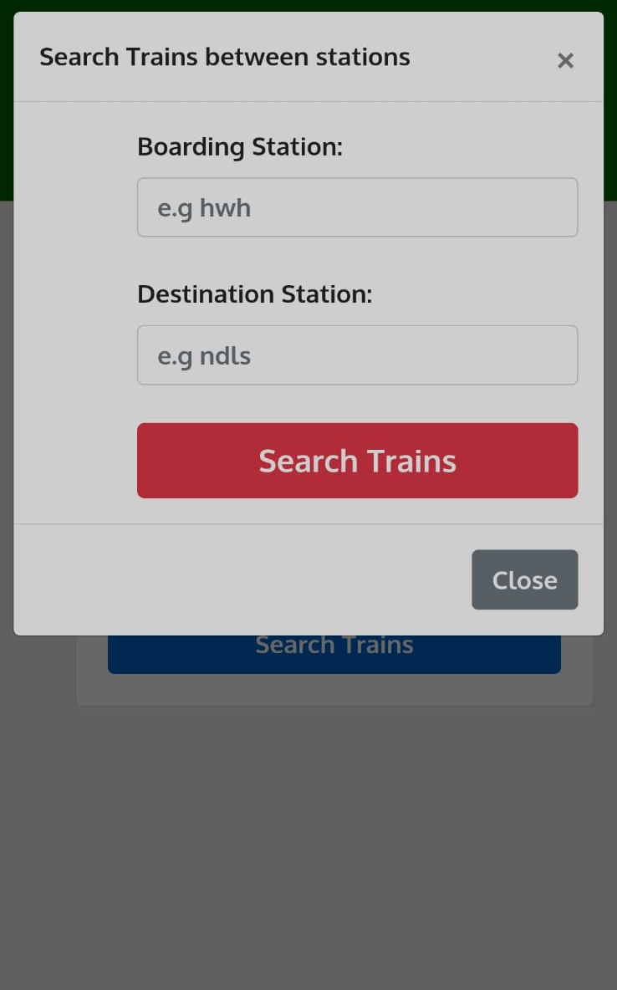
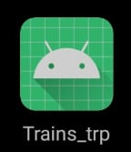
App User Interface
Fig: 3: App Interface

Slide 25
Conclusion:
By Implementing all the approach discussed above, we are getting the desired result int the form of lap’s.
If there is direct route of train is found, then we get it in the form of single lap.
But if we didn’t get any direct route. Then if there is any possibility of presence of indirect journey, we have shown it in the form of ‘n’ laps i.e lap 1, lap 2 and so on,
In this we are trying to display the fetched result form small created database.
Many various errors and bugs were removed.
Some new features like suggesting a name when someone starts typing were also added.
Issues like problems with upper case and lower case were also addressed.

Slide 26
Limitations:-
Duration of each train should also be shown.
Waiting time for each train should be shown.
Database is not that much bulky, it might be further increased.
For an instance let us suppose any train runs only on Monday, this issue should also be considered.

Slide 27
THE PROTOTYPE
Now, we have came up with front end as well as back end of the web page.
Some part of backend has been taken care of but it is still in progress.
The website has been hosted with the help of Firebase which is a platform as a service that enables developer to build run and operate applications entirely in cloud.
The developing website can be accessed on this BUTTON
BUTTON

Slide 28
REFRENCES:-
[1] Duckett, J., 2014. JavaScript and JQuery: Interactive Front-End Web Development. 1st ed. USA: Wiley, pp.7-70.
[2] S. Skiena, S., 2010. The Algorithm Design Manual. 2nd ed. Springer, pp.113-190.
[3] Cormen, T., Leiserson, C., Rivest, R. and Stein, C., n.d. Introduction to algorithms. 3rd ed. MIT Press; 3rd edition (September 1, 2009), pp.192-317.
[4] Bae, S., 2019. JavaScript Data Structures and Algorithms: An Introduction to Understanding and Implementing Core Data Structure and Algorithm Fundamentals. 1st ed. Apress, pp.167-189.
[5] Cameron, D., 2013. A Software Engineer Learns HTML5 , Javascript & Jquery. 1st ed. Createspace Independent, pp.143-168.
[6] Niederst Robbins, J., 2017. JavaScript: Programming Basics for Absolute Beginners (Step-By-Step JavaScript Book 1). 1st ed. Nathan Clark, pp.51-99.
[7] Schildt, H., 2004. Java 2. New York: McGraw-Hill/Osborne, pp.697-731.

Slide 29
Thank You

